Slide 1
Points to discuss
Document
Flowchart
Other
Data export
One mistake: ‘\n’ still in pgp, will make new export
Visualisation
Dashboard setup
Network graph
Planning last month

Slide 2
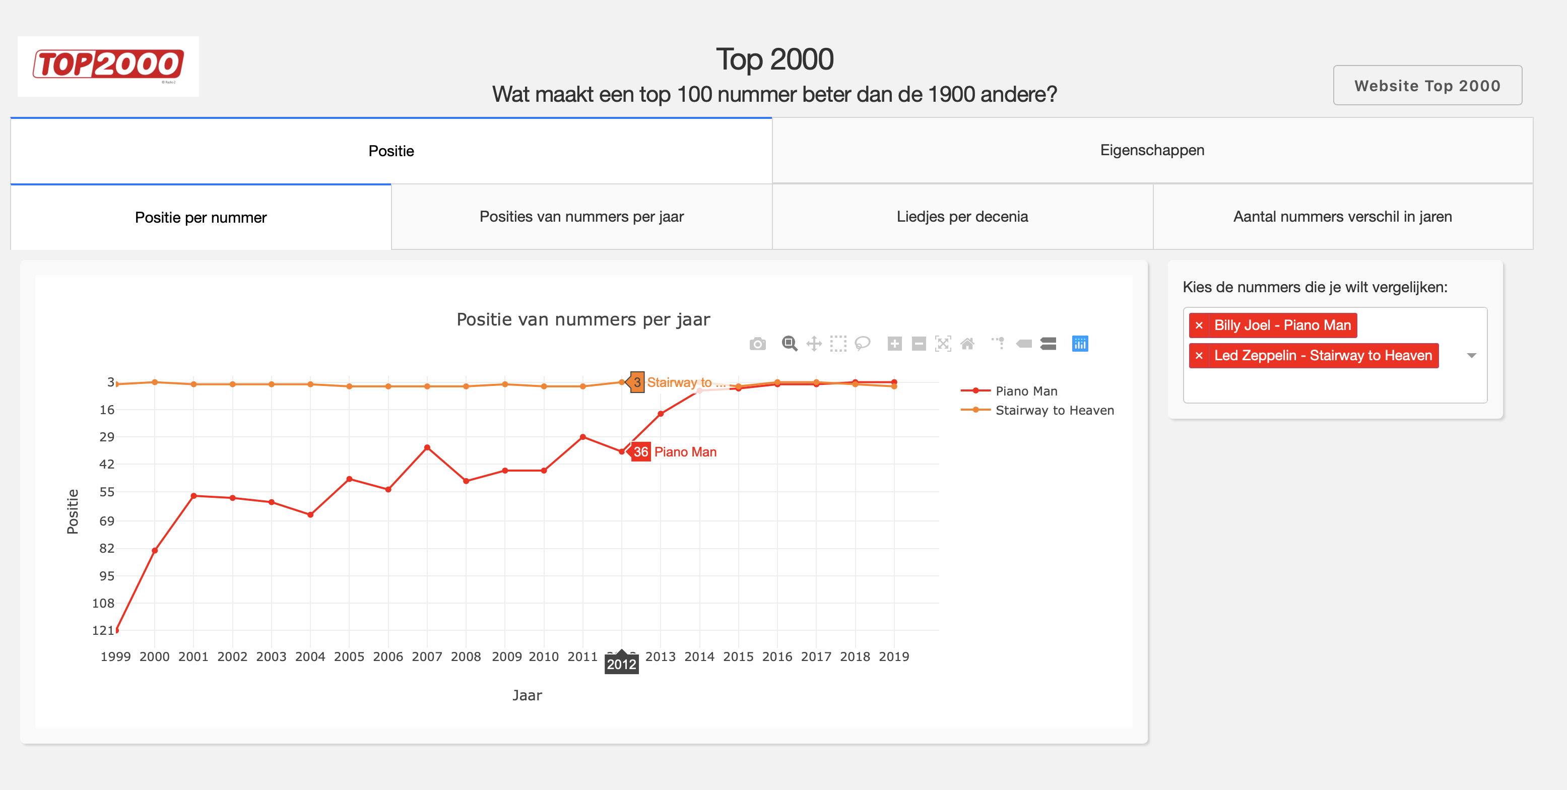

Slide 3
Packages used (visualisation specific)
Plotly
Plotly’s DASH
networkX

Slide 4
ANITA TREND ANALYSIS
Tab1: Descriptives
Tab2: Network graph
Tab3: Specifics

Slide 5
ANITA TREND ANALYSIS
Tab1: Descriptives
Tab2: Network graph
Tab3: Specifics
Give information about the data (market level)
Filter:
Period selection
Market selection
Data
# Unique vendors (bar chart per market + total)
# Unique products (bar chart per market + total)
# overlapping pgp / names across markets (textual)
Some examples (textual)

Slide 6
ANITA TREND ANALYSIS
Tab1: Descriptives
Tab2: Network graph
Tab3: Specifics
Show network graph for selection
Filter:
Market selection
Select name of vendors from overlapping PGP or name
Show Network graph:
Hover information
Simple full name
ClickOn information
Content of the dataset (table format)
Simple descriptives (example: how many extraction dates in dataset)

Slide 7
ANITA TREND ANALYSIS
Tab1:Descriptives
Tab2: Network graph
Tab3: Specifics
Subtab1: Product
Subtab2: Vendor
Show specific graphs for selection (product & vendor level)
Filter:
Market selection
Period selection
Select name of vendors or products
Information shown:
Trend of sales (if sales in dataset, line plot)
Information (score, shipping etc., textual)

Slide 8
To-do list
Share document with Giuseppe and Daniel (TU/e word?)
Create and add remaining flow charts
Create concept version Dashboard (working)
Add all the graphs
Proposal: +- 11 June meeting to discuss the document + flowcharts
+- 18 June meeting to discuss the dashboard
+- 25 June meeting to wrap-up and last fixes/questions
+- 2 July last meeting to check if everything is ok

